Slide 1
Unit 7: ArrayList

AP CS A
Ms. Baniqued

Slide 2
Review
List as many ArrayList methods as you can from memory.

Slide 3
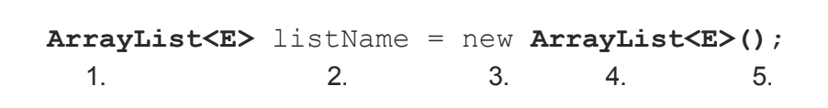
Introduction to ArrayList
An ArrayList is a Java Collections Framework data structure that allows the programmer to instantiate and store related object reference data.
Unlike the array, the ArrayList is a resizable data structure. References can be added and removed at any time, and the size of the ArrayList will be adjusted.
Like the array, the programmer creates one variable and has access to many variables, called elements of the ArrayList, through that one named reference variable. Using an ArrayList with its methods provides a convenient way to store, access, and maintain information for a group of related same-type reference variables.
Declaring and Instantiating an ArrayList
Declare the ArrayList variable using the type ArrayList with the element type (generic type) enclosed in <>. E is a placeholder for some object type.
Name the variable.
Use the new keyword to instantiate the ArrayList object.
Repeat the ArrayList with the genertic type used in the variable declaration.
Follow with () because this is a call to the ArrayList constructor.

Slide 4
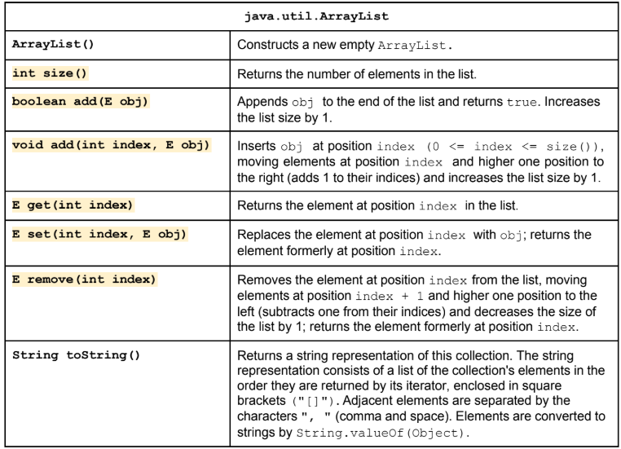
ArrayList Methods

Slide 5
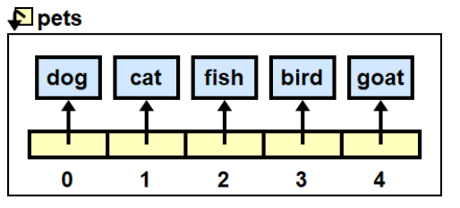
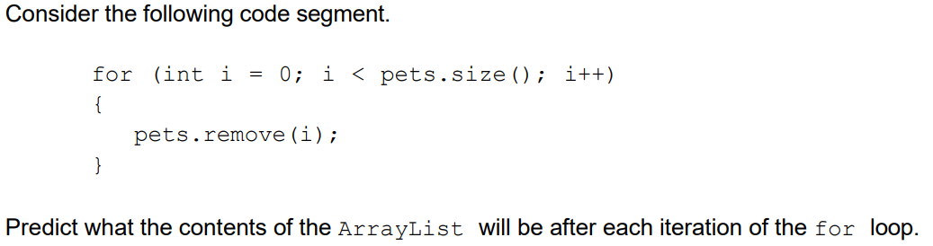
Removing ArrayList elements
Assume that the pets ArrayList has been instantiated and contains the following items:

Slide 6
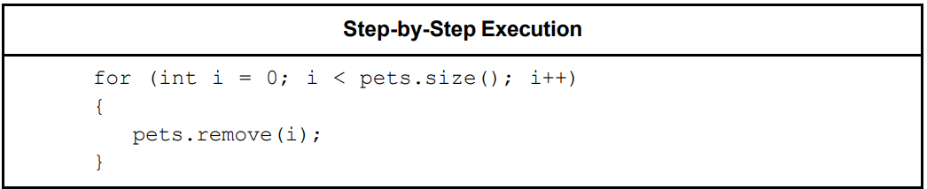
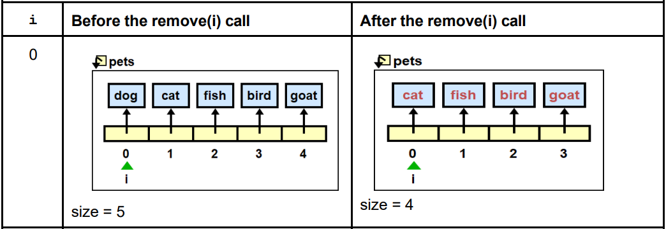
Removing ArrayList elements

Slide 7
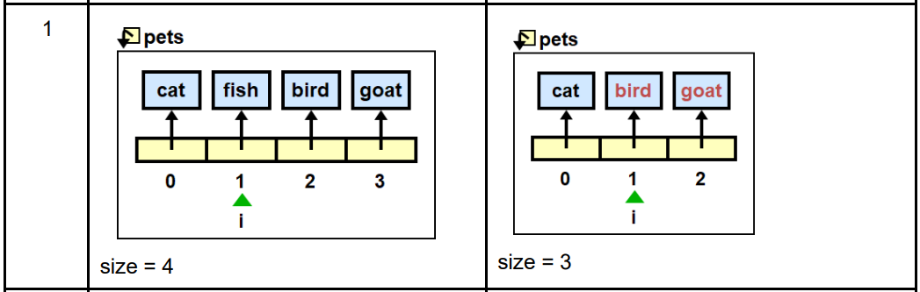
Removing ArrayList elements
i =

Slide 8
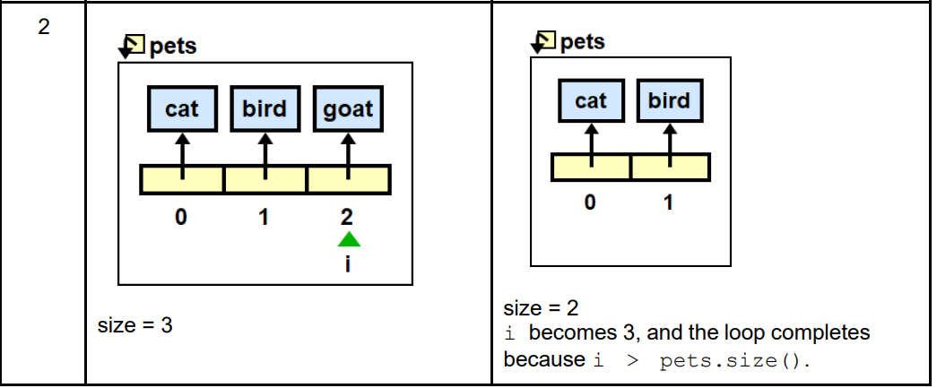
Removing ArrayList elements

Slide 9
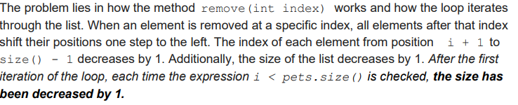
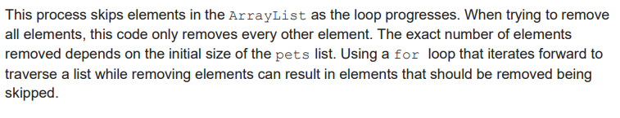
The Issue: Shifting of Elements

Slide 10
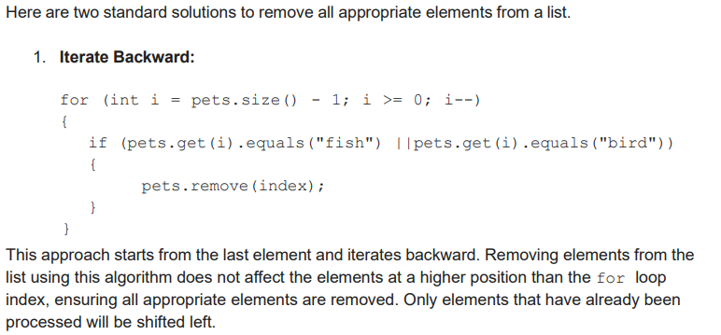
Removing ArrayList elements: Solution 1

Slide 11
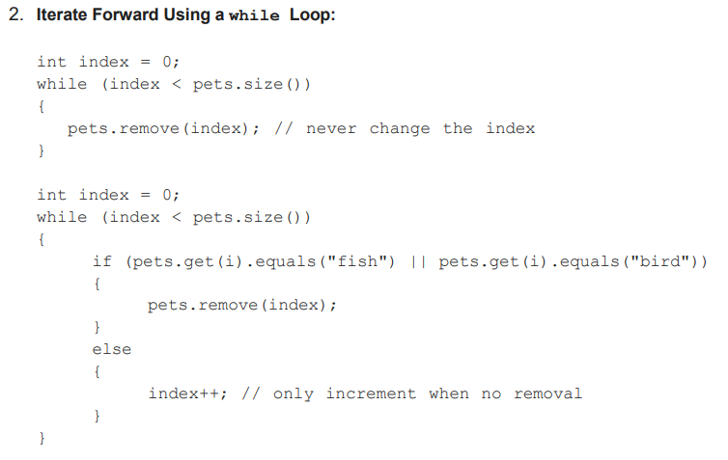
Removing ArrayList elements: Solution 2
This approach uses a while loop starting at the first element and only increments index if the remove method is not called. When an element is removed from the list, index doesn’t change, allowing the shifted element to be checked in the next iteration of the loop.

